Slide 1
BLM2041 Signals and Systems
Syllabus
The Instructors:
Doç. Dr. Ali Can Karaca
ackaraca@yildiz.edu.tr
Dr. Öğr. Üyesi Erkan Uslu
euslu@yildiz.edu.tr

Slide 2
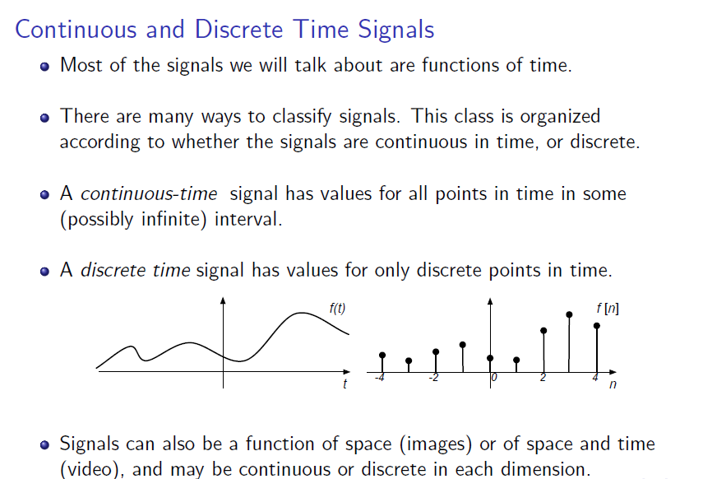
Signals and Systems Properties

Slide 3
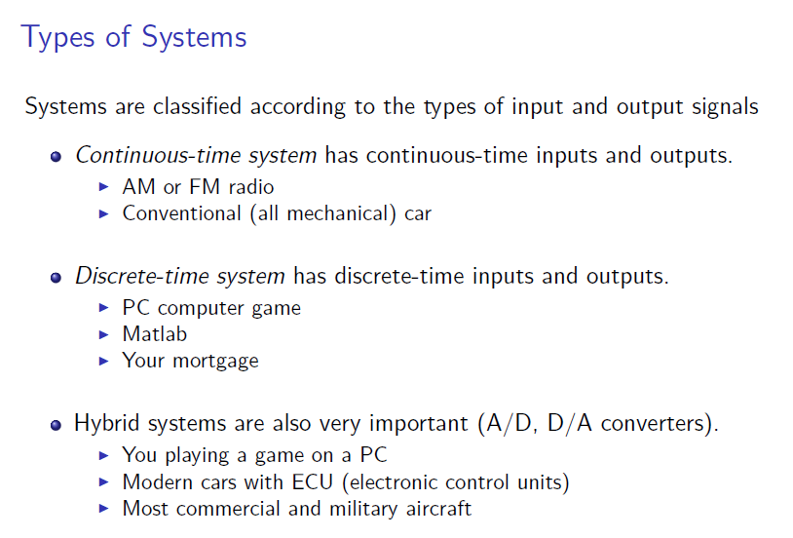
Signals and Systems Properties

Slide 4
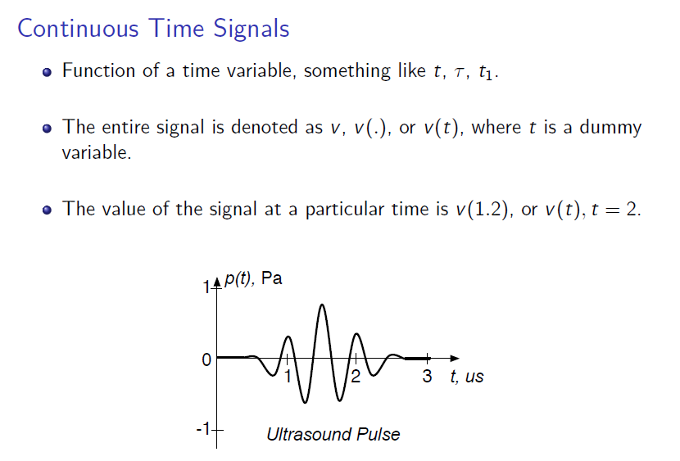
Signals and Systems Properties

Slide 5
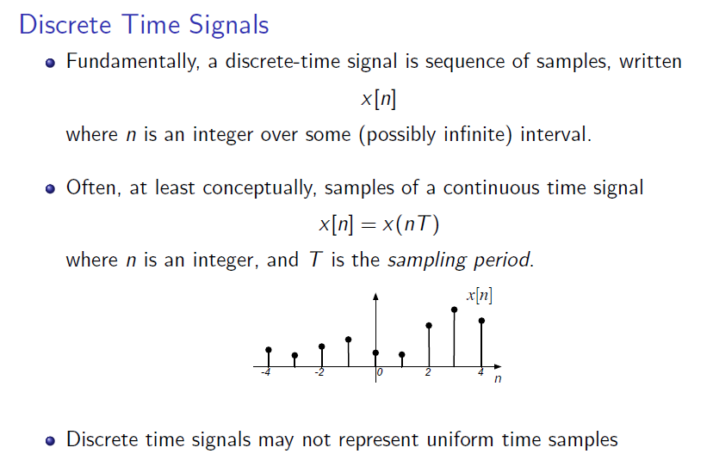
Signals and Systems Properties

Slide 6
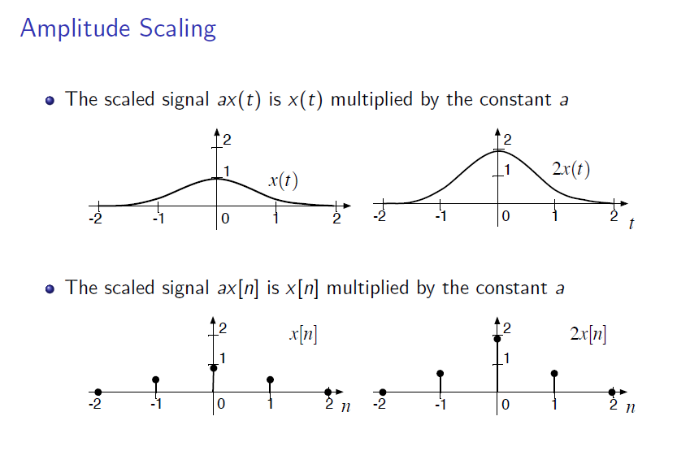
Operations on Signals

Slide 7
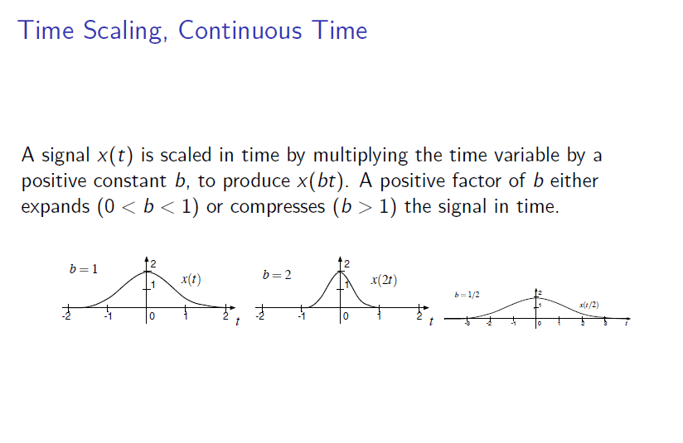
Signals and Systems Properties

Slide 8
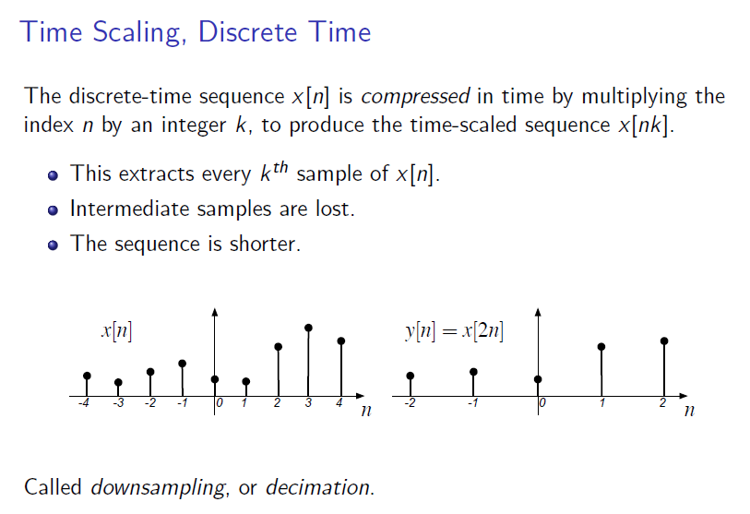
Signals and Systems Properties

Slide 9
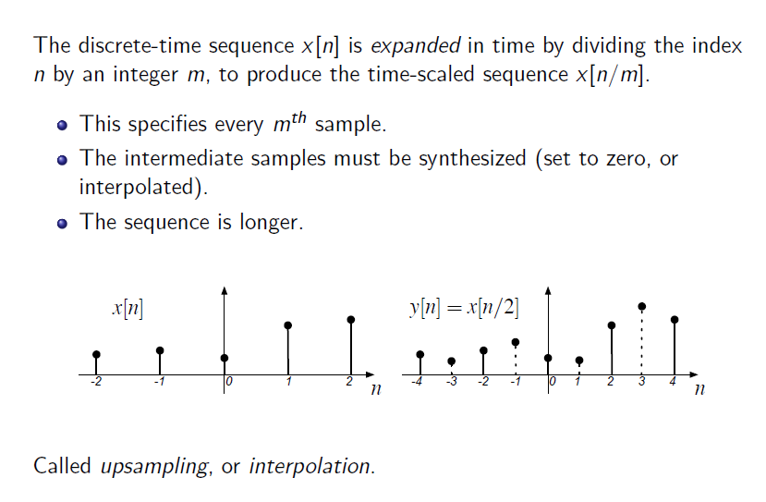
Signals and Systems Properties

Slide 10
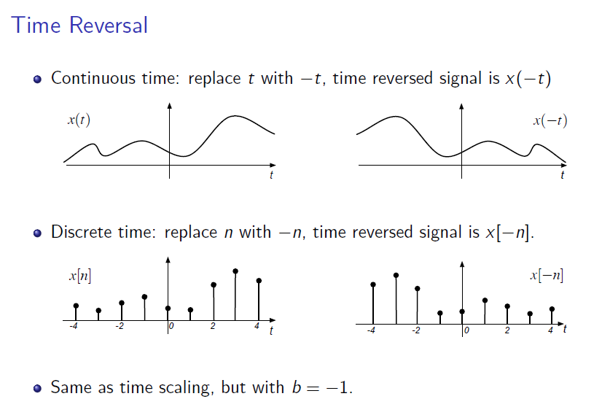
Signals and Systems Properties

Slide 11
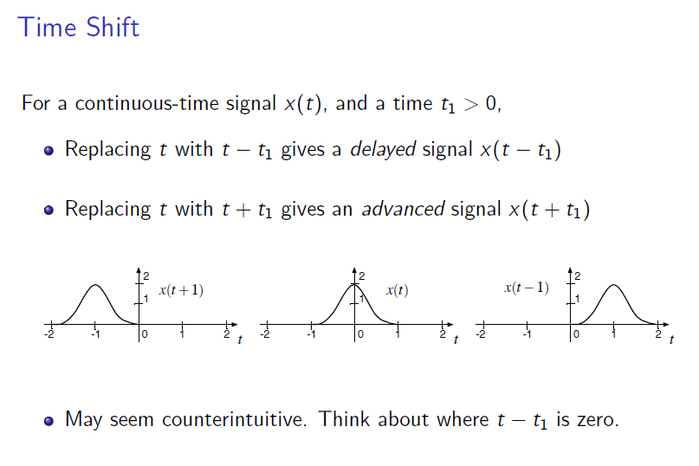
Signals and Systems Properties

Slide 12
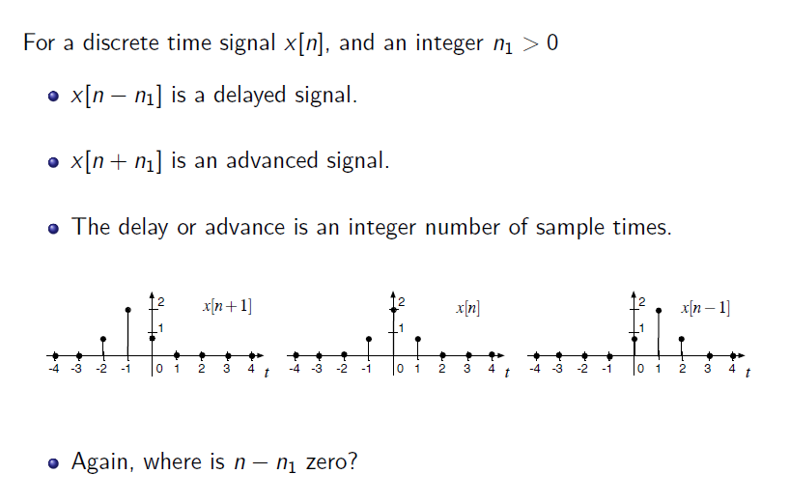
Signals and Systems Properties

Slide 13
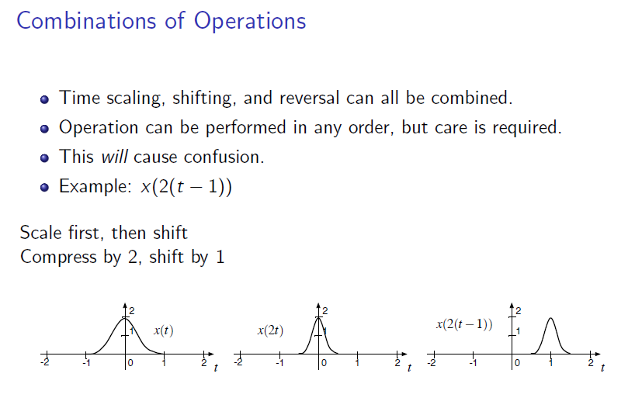
Signals and Systems Properties

Slide 14
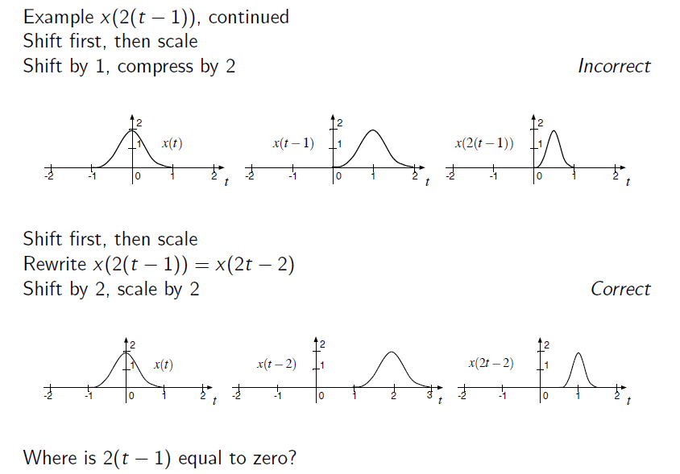
Signals and Systems Properties

Slide 15
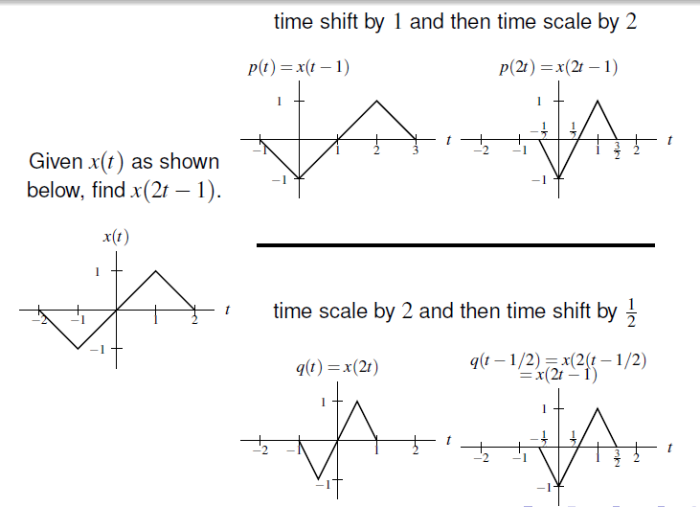
Örnek
y(t) = x(2t -1) işaretini
çiziniz.
2 farklı yol var:
Önce zamanda ötele,
Sonra zamanda ölçekle
2) Önce zamanda ökçekle,
sonra zamanda ötele.

Slide 16
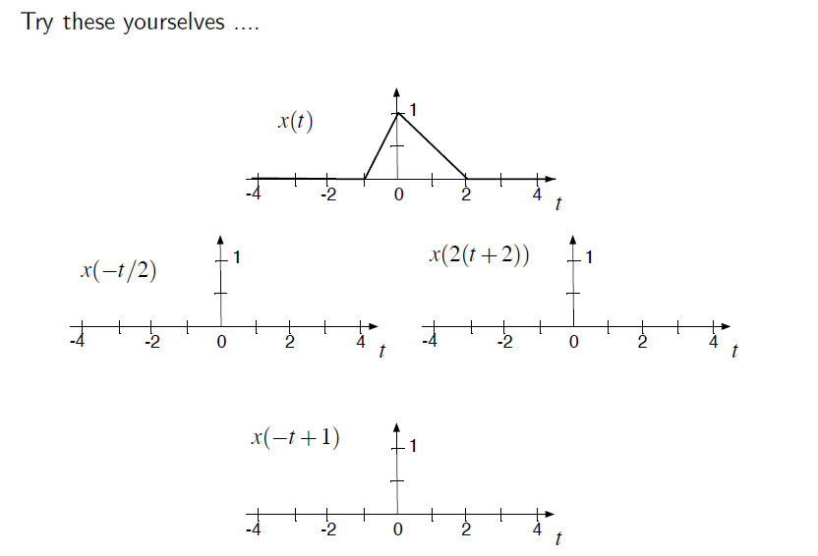
Signals and Systems Properties

Slide 17
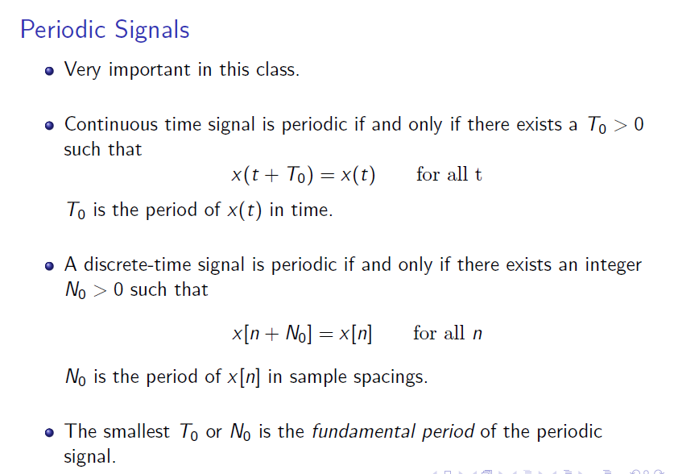
Signals and Systems Properties

Slide 18
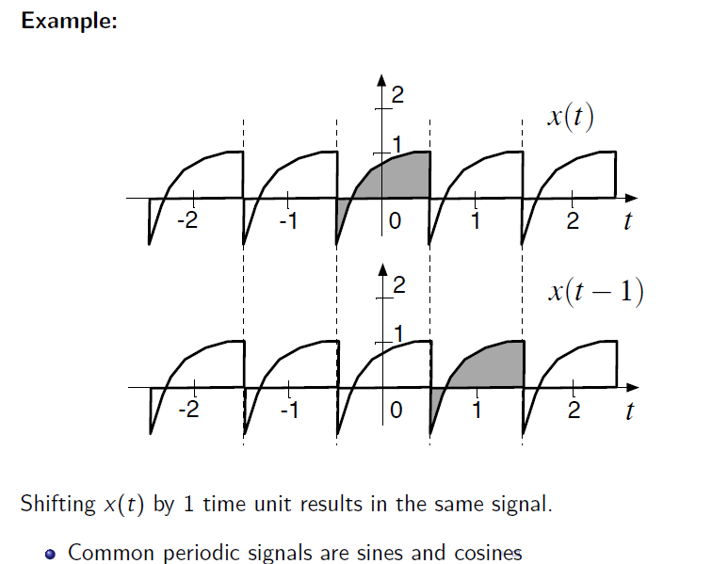
Signals and Systems Properties

Slide 19
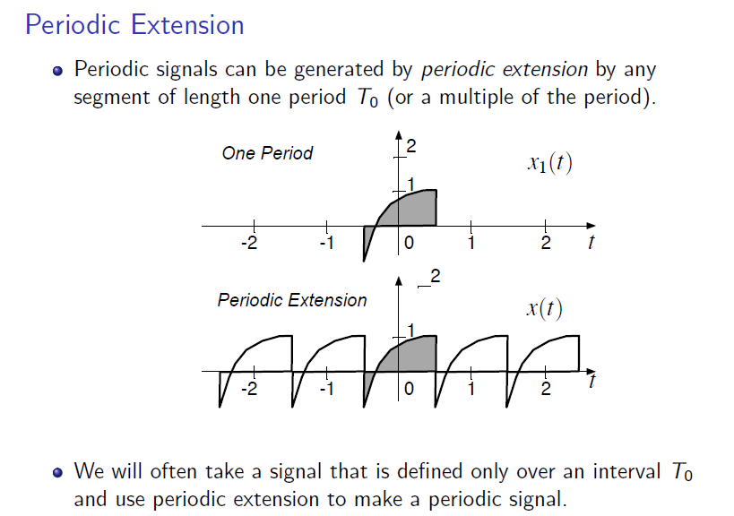
Signals and Systems Properties

Slide 20
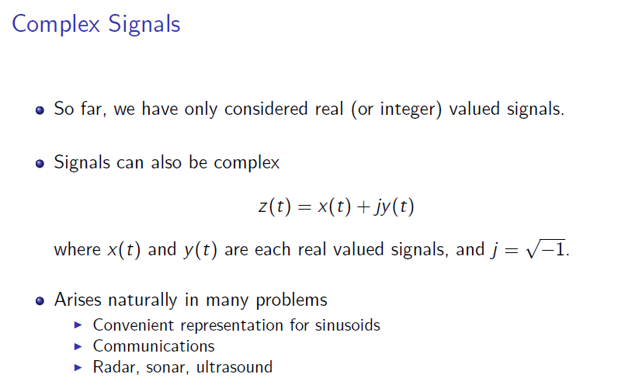
Signals and Systems Properties

Slide 21
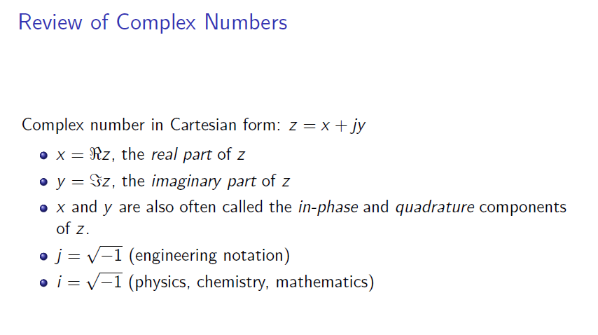
Signals and Systems Properties

Slide 22
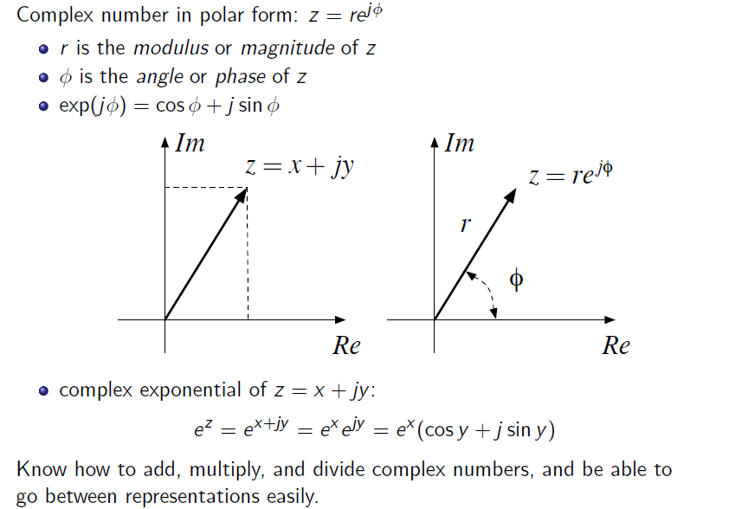
Signals and Systems Properties

Slide 23
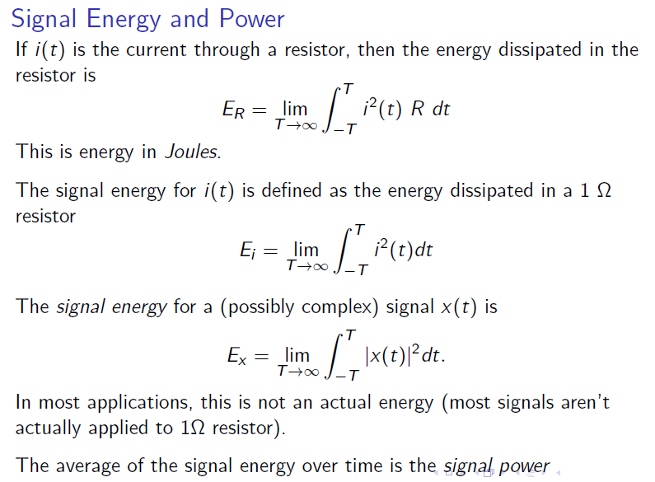
Signals and Systems Properties

Slide 24
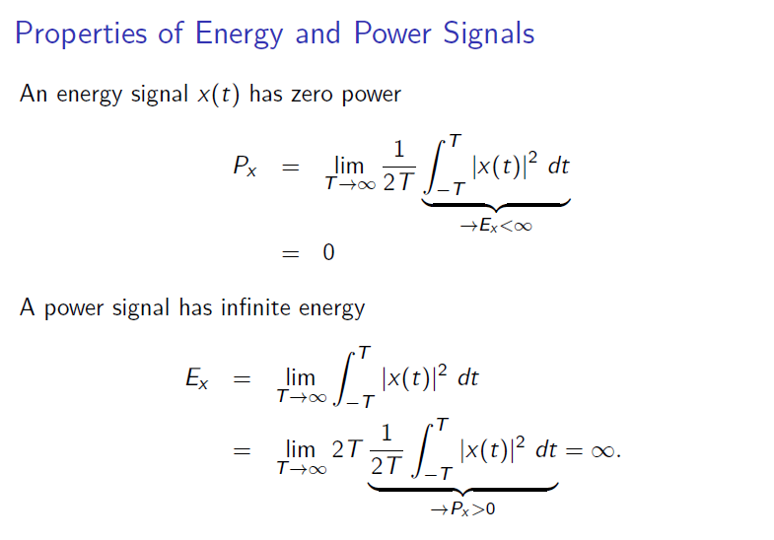
Signals and Systems Properties

Slide 25
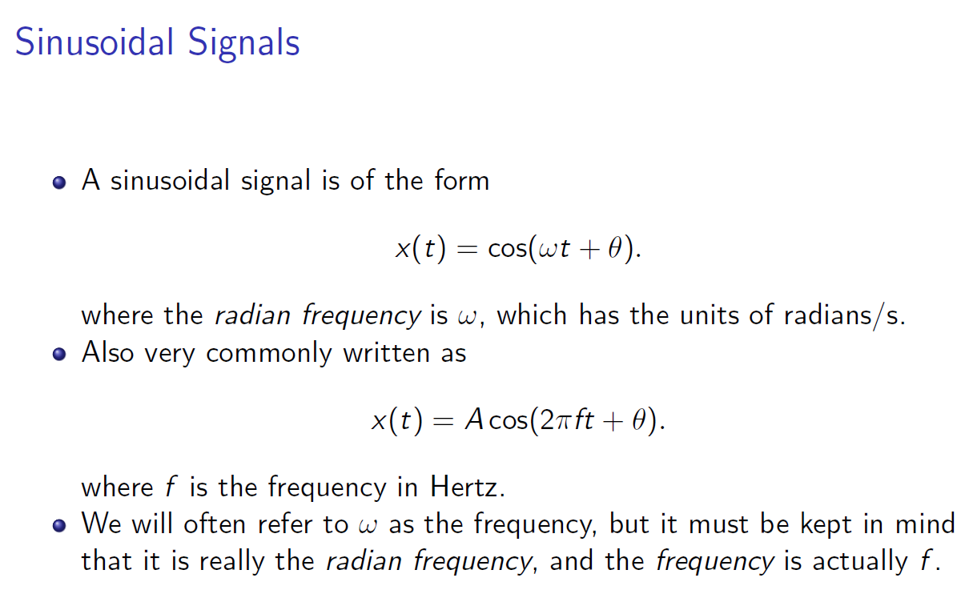
Signals and Systems Properties

Slide 26
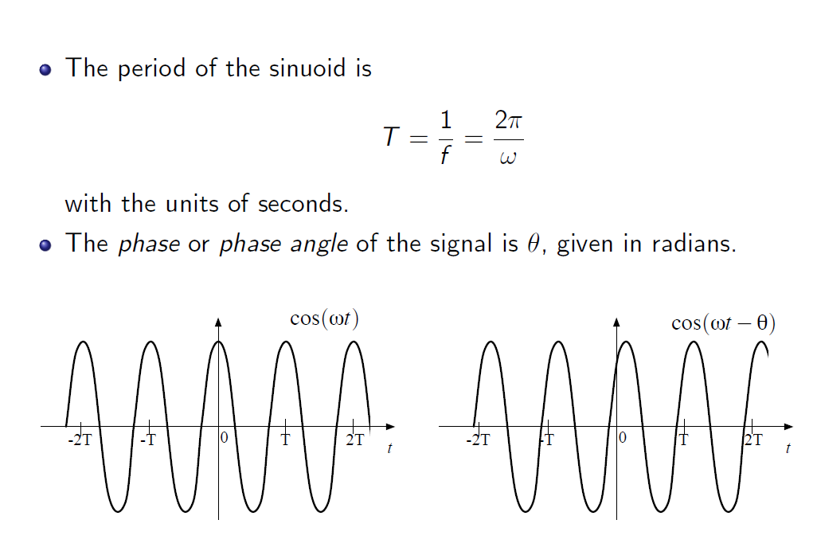
Signals and Systems Properties

Slide 27
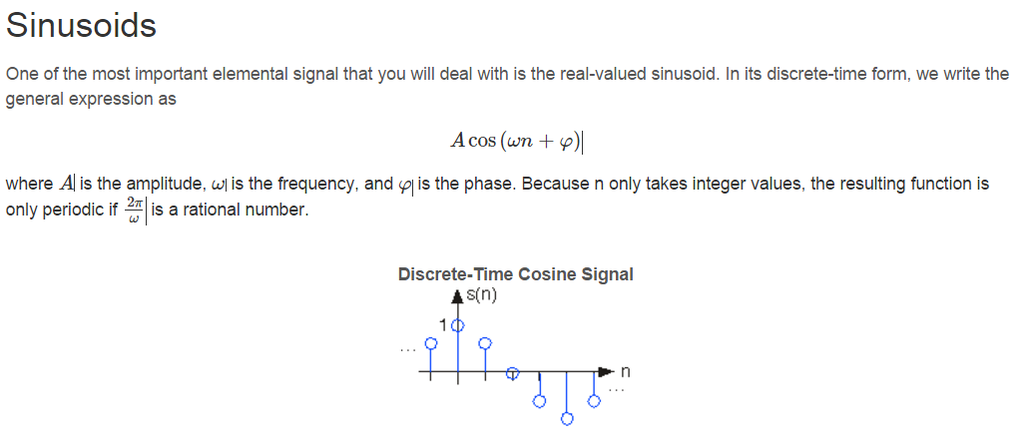
Signals and Systems Properties

Slide 28
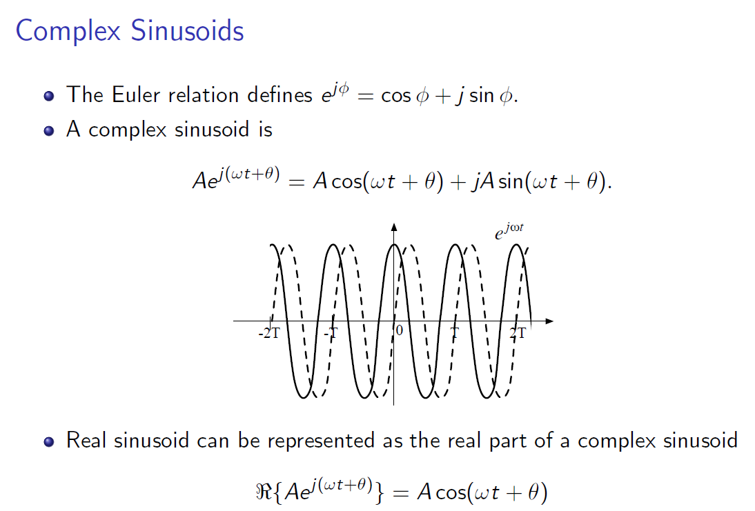
Signals and Systems Properties

Slide 29
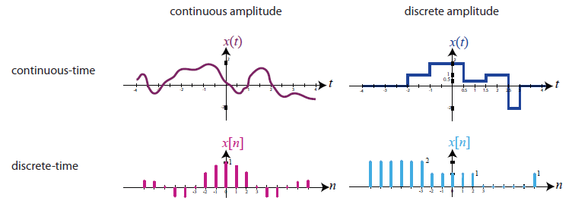
Analog ve Sayısal İşaretler
Analog İşaret -> sürekli zaman ve sürekli genlik değerleri
Sayısal İşaret -> ayrık zaman ve ayrık genlik değerleri

Slide 30
clear all;
load train;
%% Example---Listening to/plotting train signal
sound(y,Fs)
t=0:1/Fs:(length(y)-1)/Fs;
figure(2); plot(t,y'); grid
ylabel('y[n]'); xlabel('n')
%% Example---Using stem to plot 200 samples of train
figure(3)
n=100:299;
stem(n,y(100:299)); ylabel('y[n]'); xlabel('n')
title('Segment of train signal')
axis([100 299 -0.5 0.5])

Slide 31
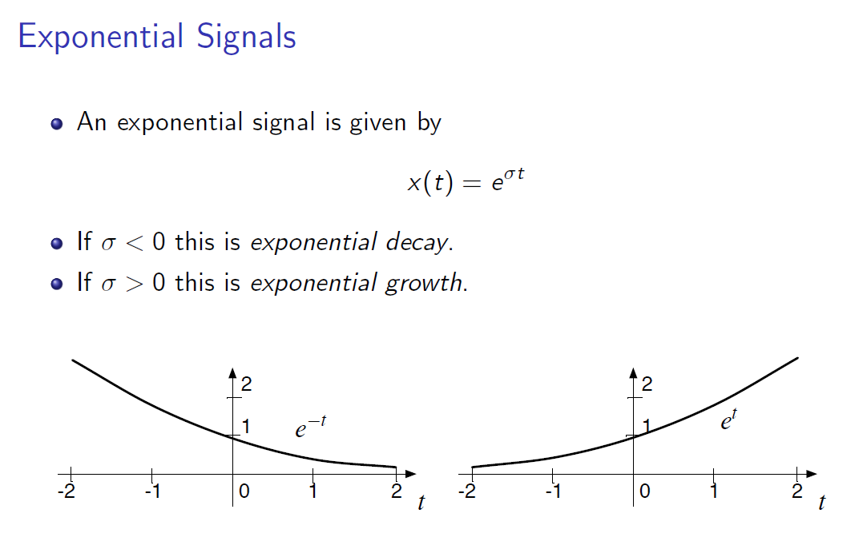
Signals and Systems Properties

Slide 32
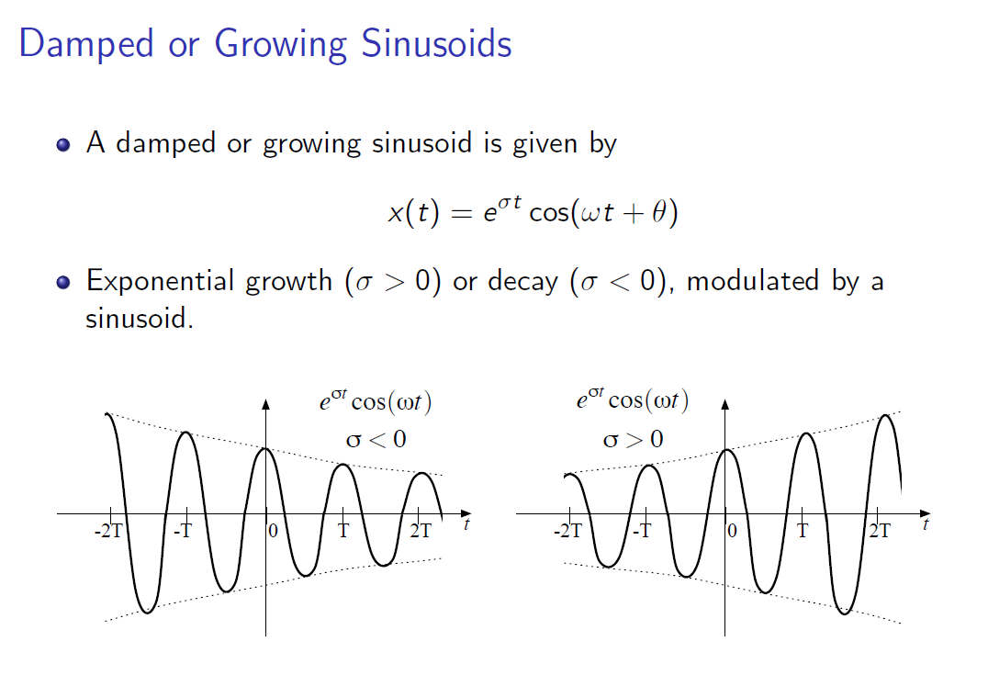
Signals and Systems Properties

Slide 33
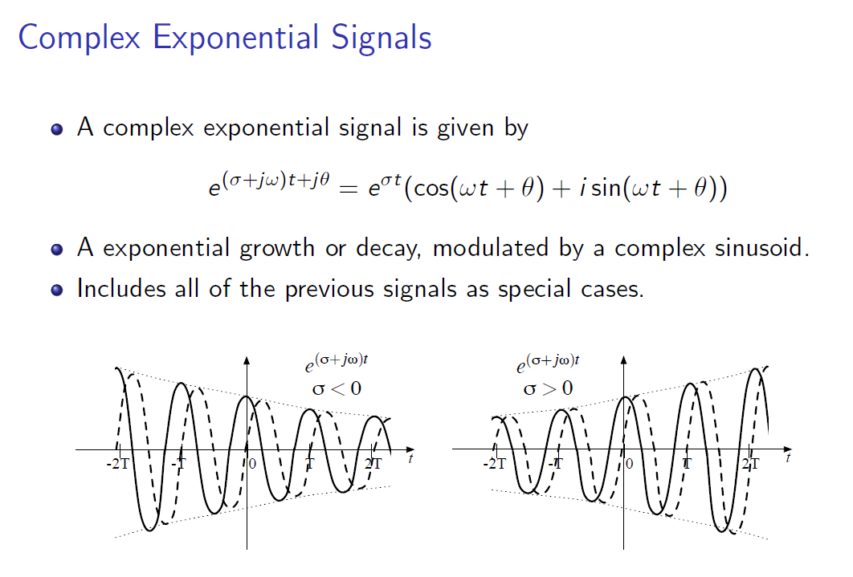
Signals and Systems Properties

Slide 34
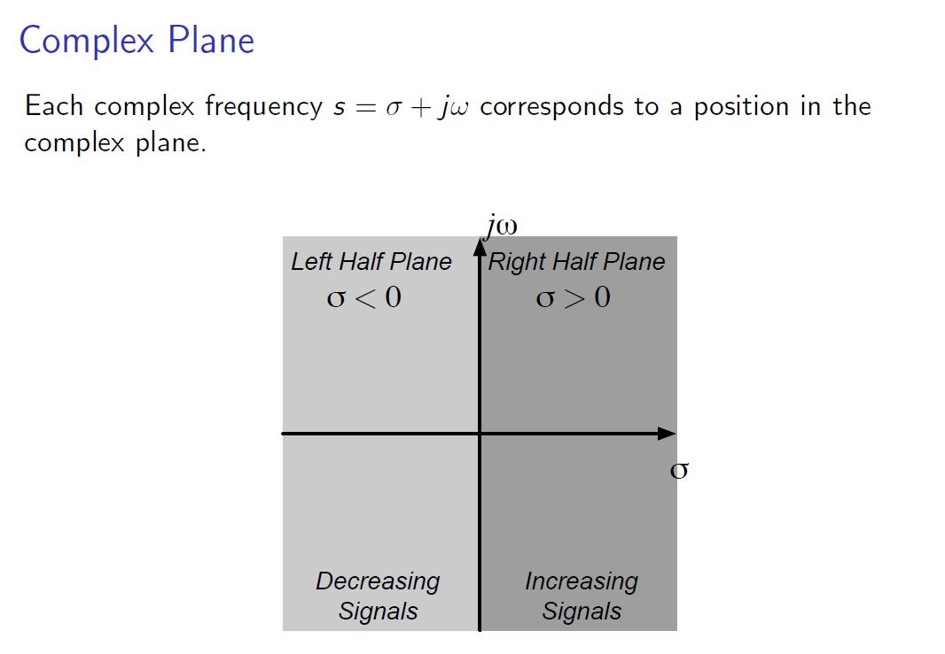
Signals and Systems Properties

Slide 35
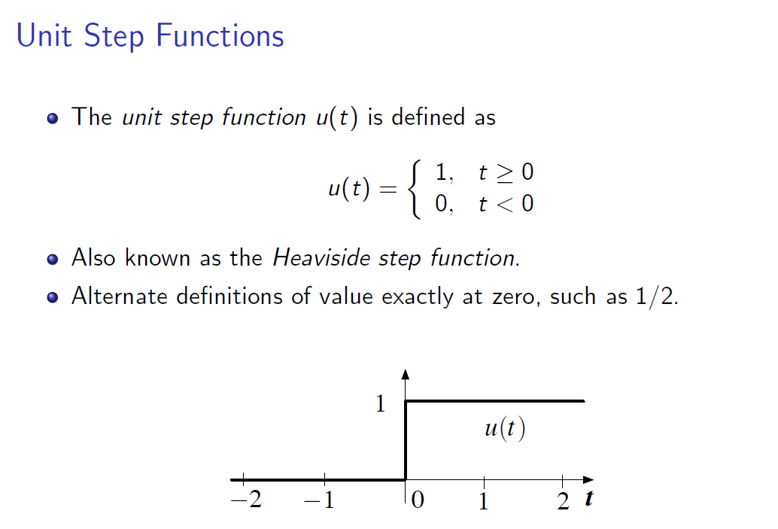
Signals and Systems Properties

Slide 36
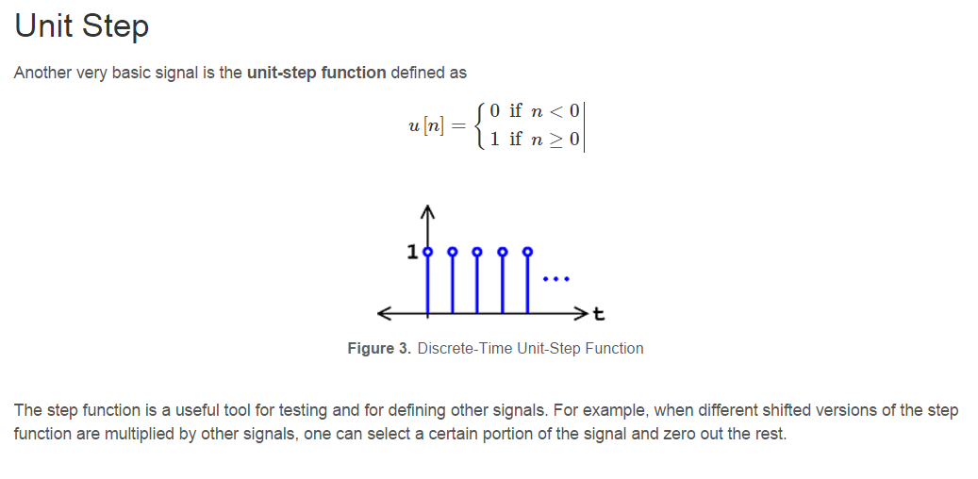
Signals and Systems Properties
Birim basamak işareti:
clc; clear all;
%%
n=-10:10;
x = 0.*n;
for i=1:length(n)
if (n(i)>=0)
x(i)=1;
end
end
stem(n,x,'filled');

Slide 37
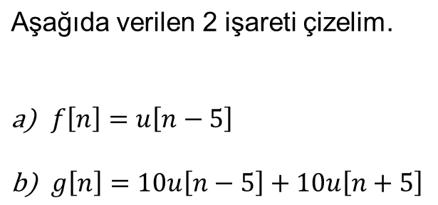
Örnek:

Slide 38
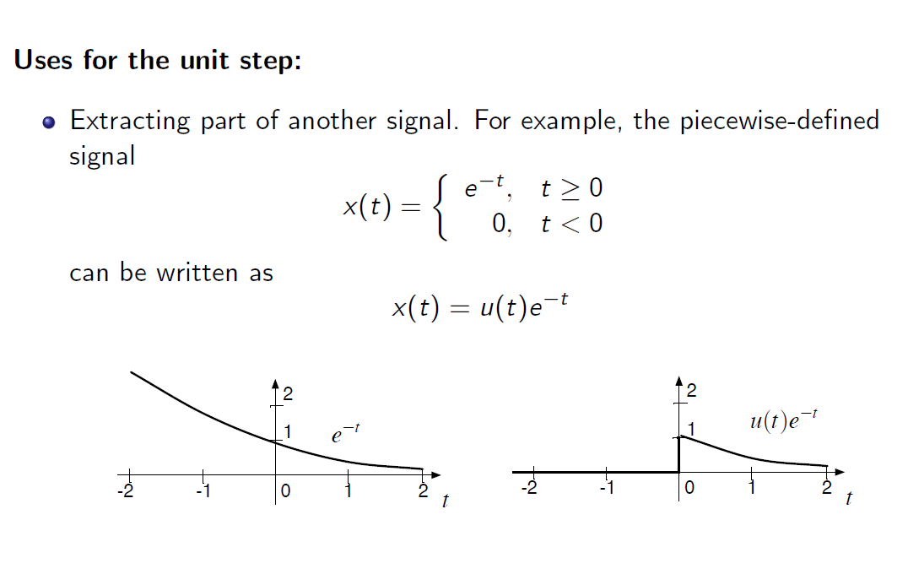
Signals and Systems Properties

Slide 39
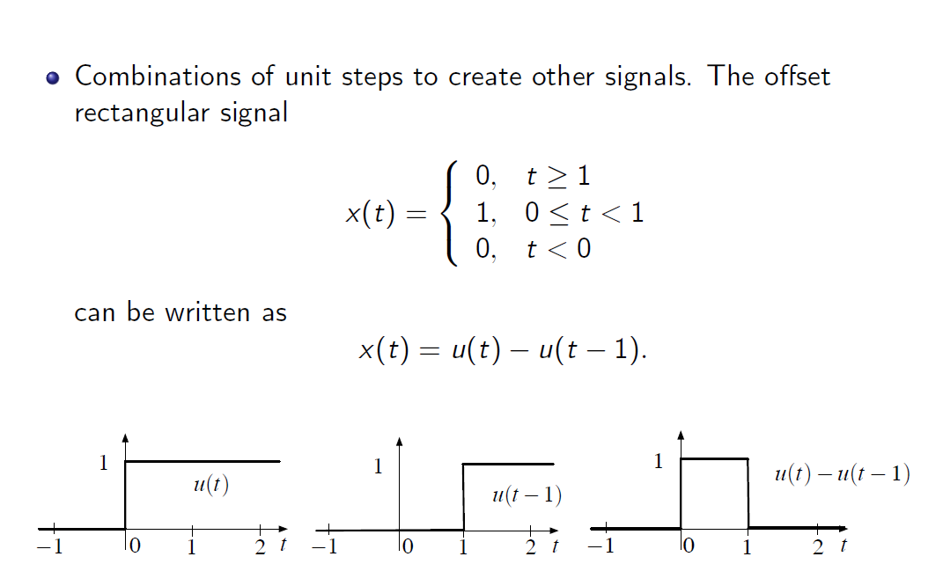
Signals and Systems Properties

Slide 40
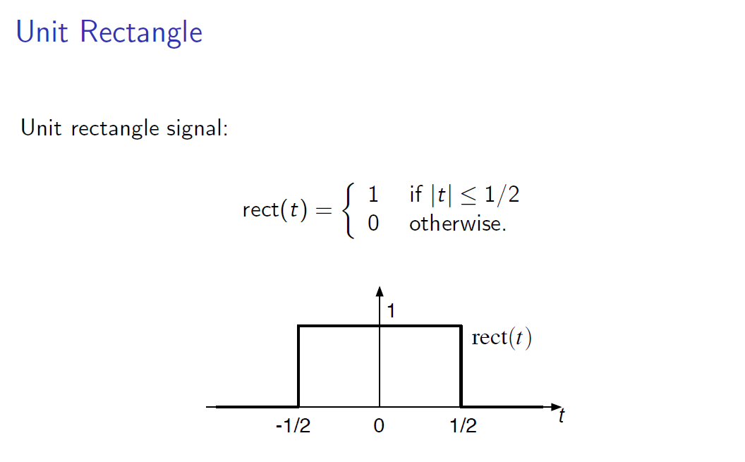
Signals and Systems Properties

Slide 41
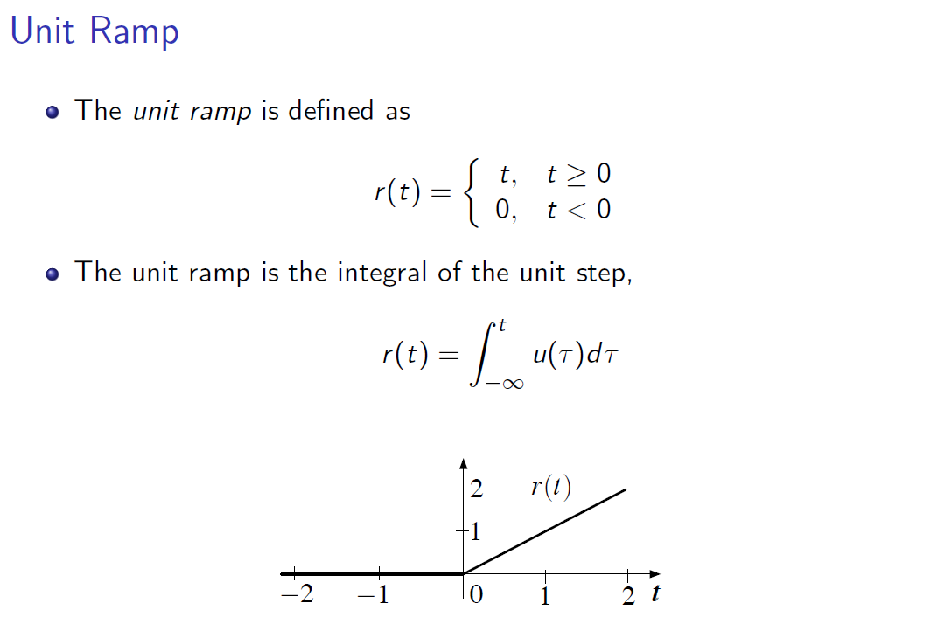
Signals and Systems Properties

Slide 42
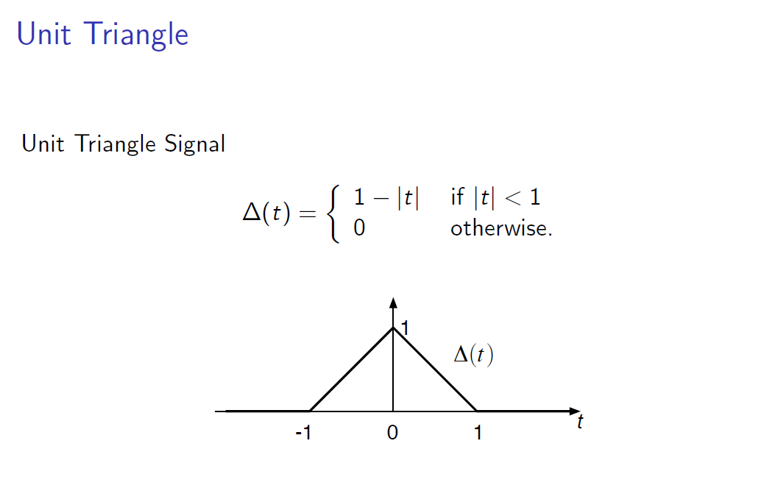
Signals and Systems Properties

Slide 43
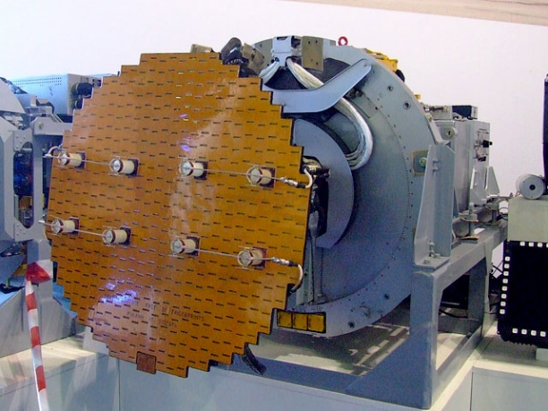
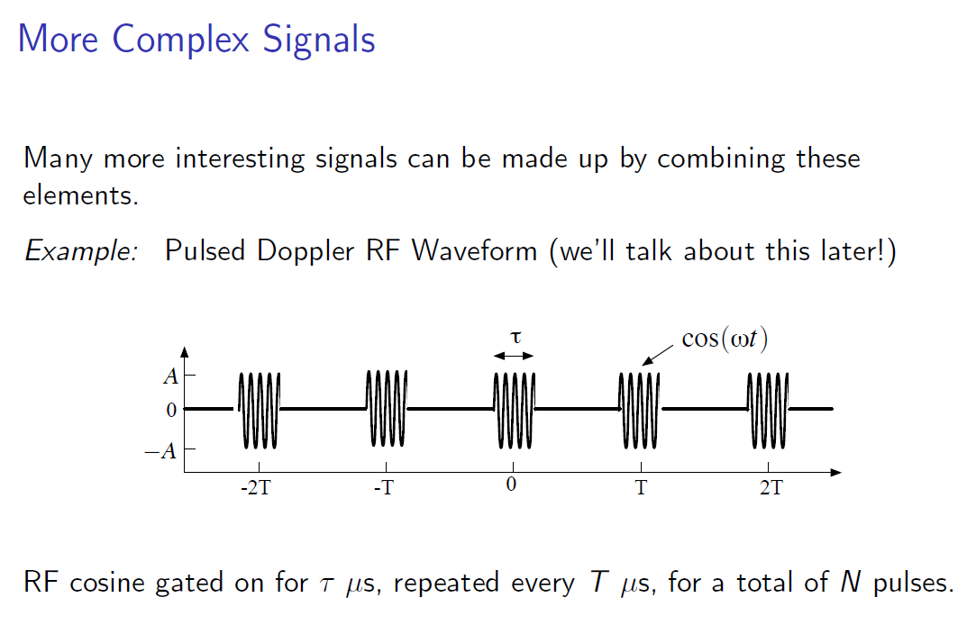
Signals and Systems Properties
Notes:
RADAR

Slide 44
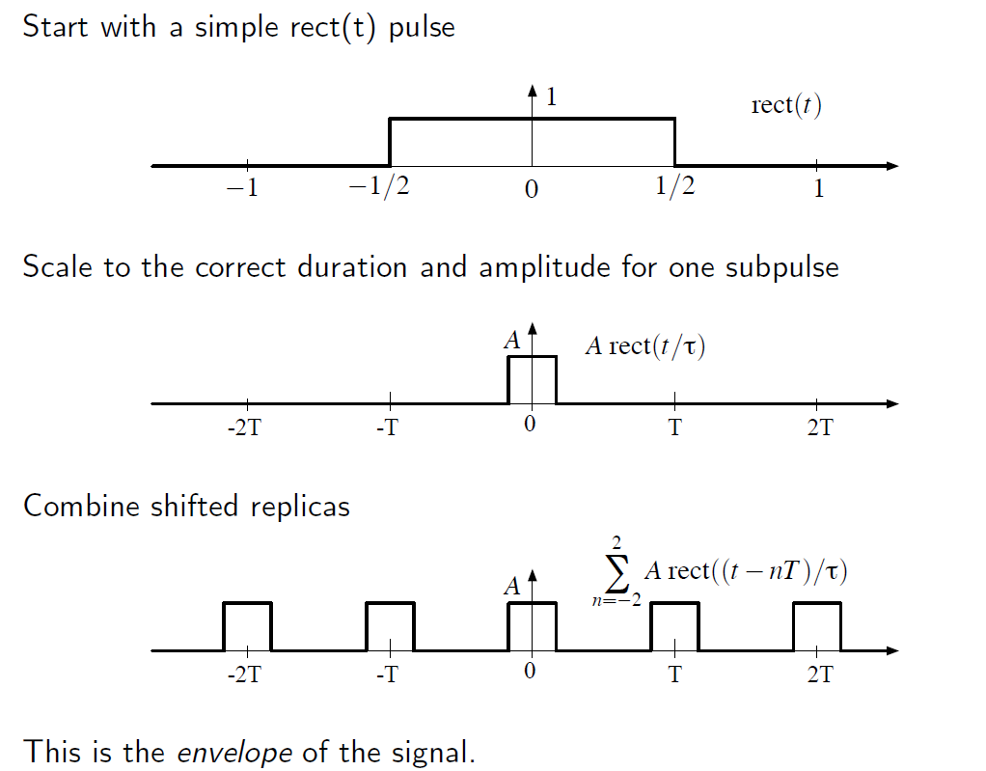
Signals and Systems Properties

Slide 45
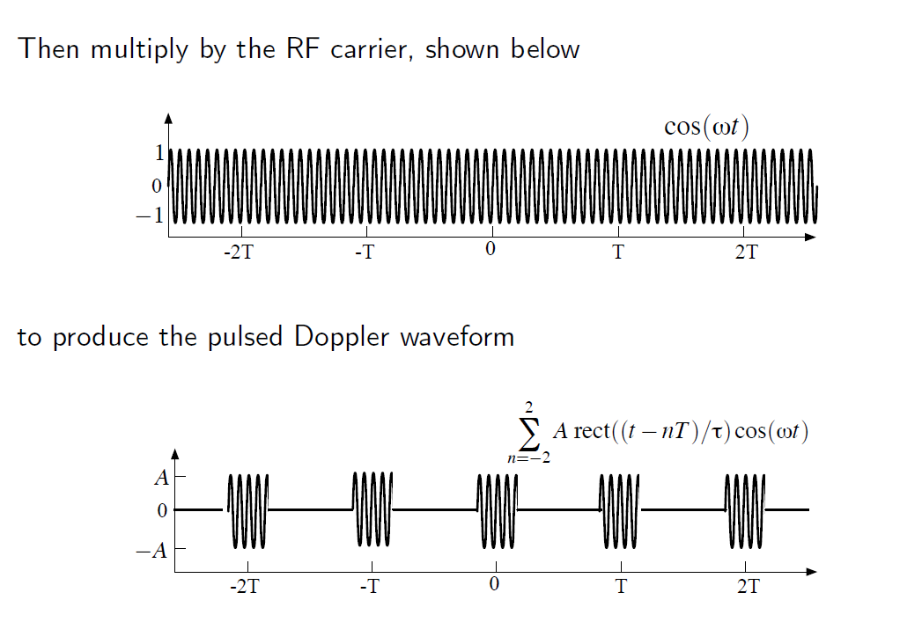
Signals and Systems Properties

Slide 46
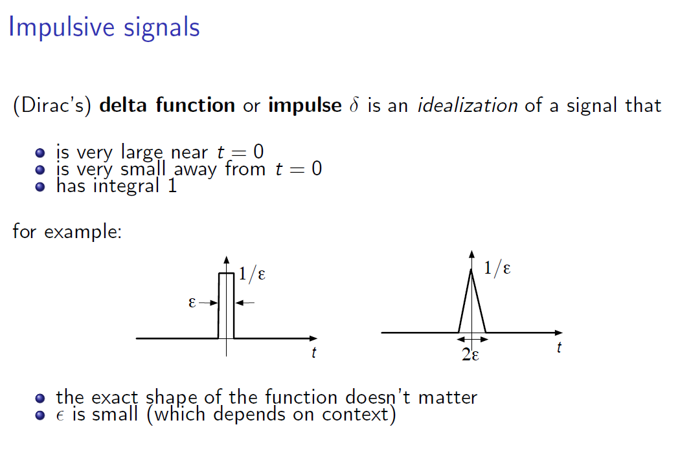
Signals and Systems Properties

Slide 47
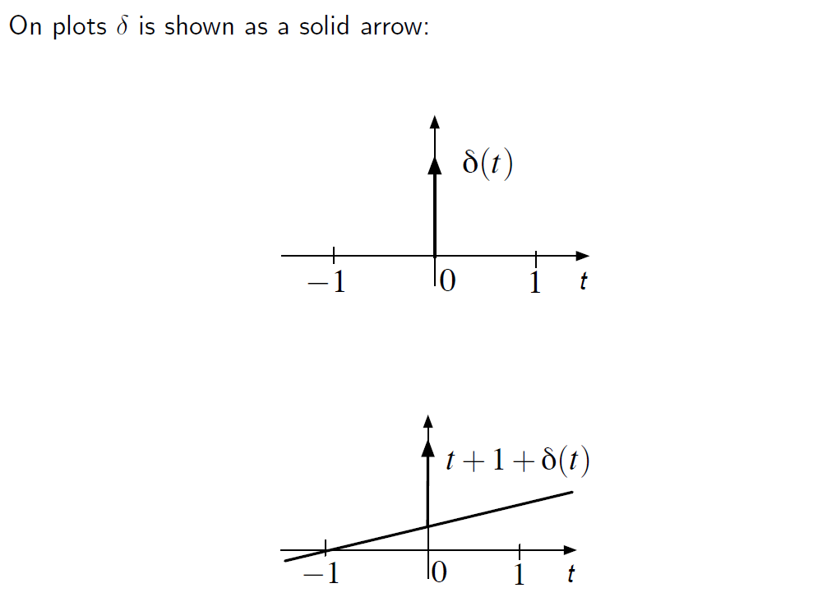
Signals and Systems Properties

Slide 48
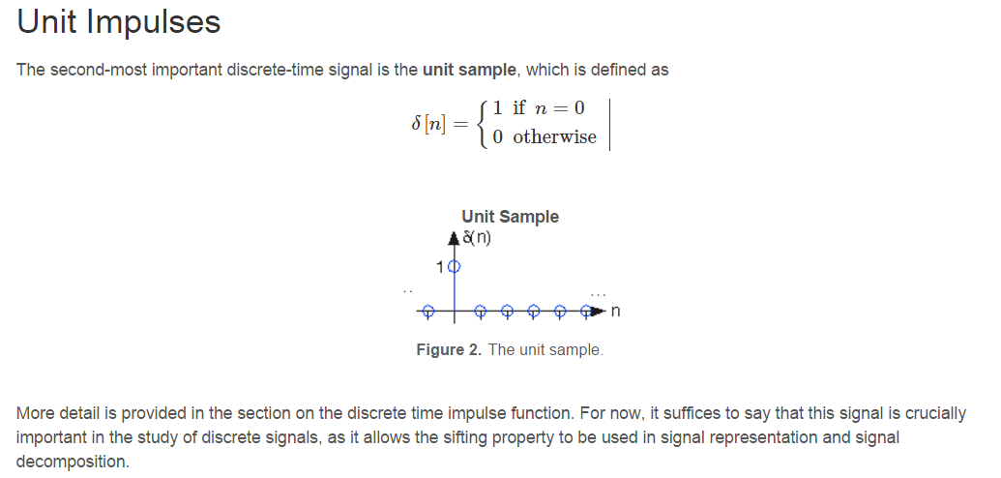
Signals and Systems Properties
Birim dürtü işareti:
clc; clear all;
%%
n=-10:10;
x = 0.*n;
for i=1:length(n)
if (n(i)>=0)
x(i)=1;
end
end
stem(n,x,'filled');

Slide 49
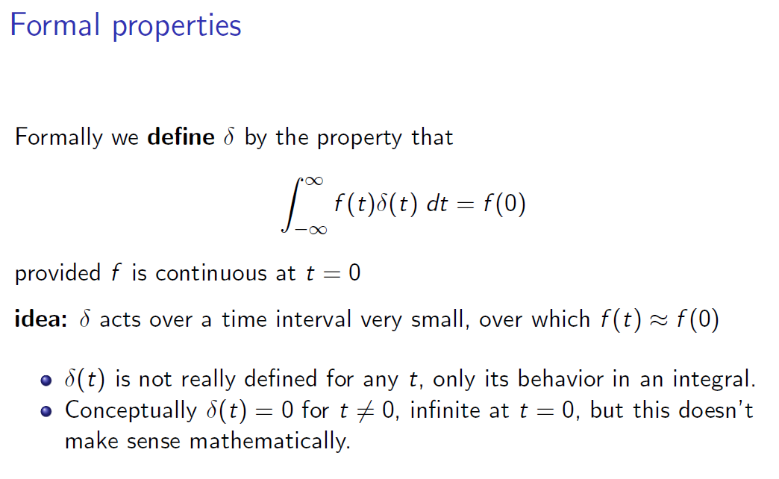
Signals and Systems Properties

Slide 50
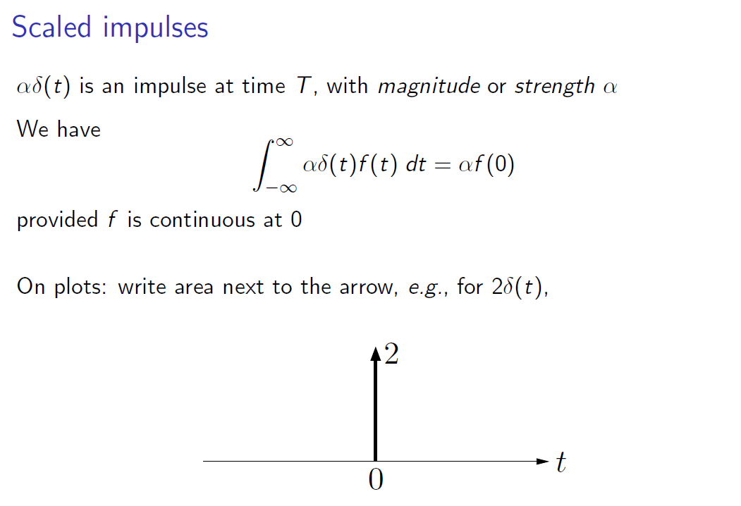
Signals and Systems Properties

Slide 51
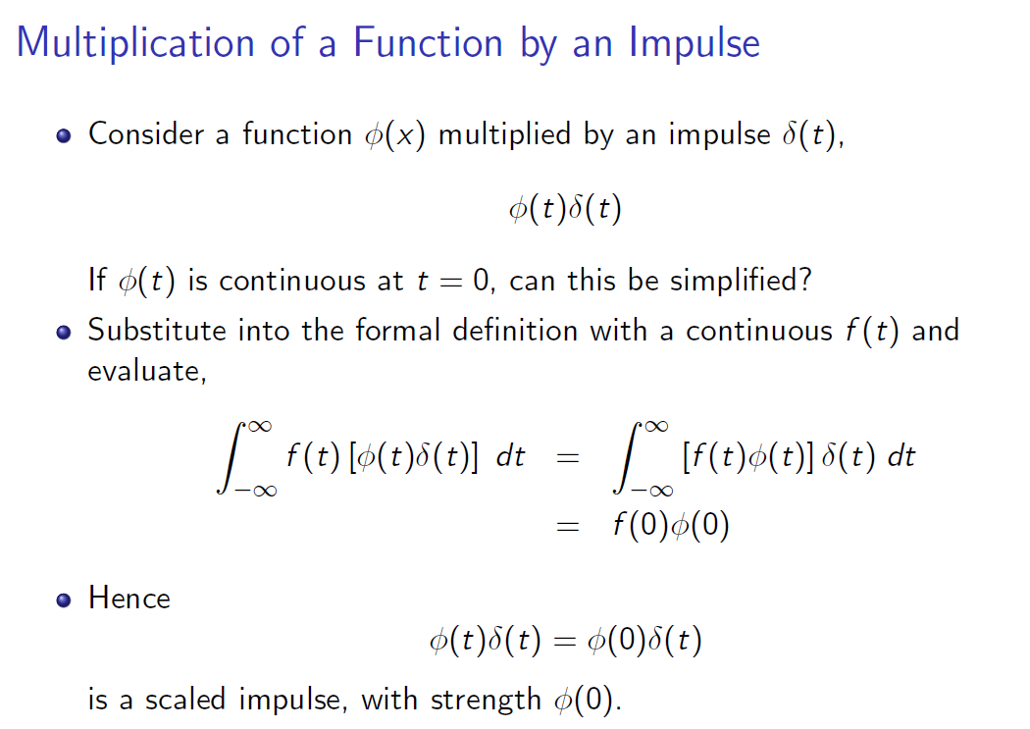
Signals and Systems Properties

Slide 52

Signals and Systems Properties
Notes:
Eleme özelliği

Slide 53

Signals and Systems Properties

Slide 54

Signals and Systems Properties

Slide 55

Signals and Systems Properties
Notes:
Çekiş vurma sesi, Teniste topa vurma sesi bat hitting ball

Slide 56

Signals and Systems Properties

Slide 57

Signals and Systems Properties
Notes:
Saklamak - obscure

Slide 58

Signals and Systems Properties

Slide 59

Signals and Systems Properties

